Slide 1
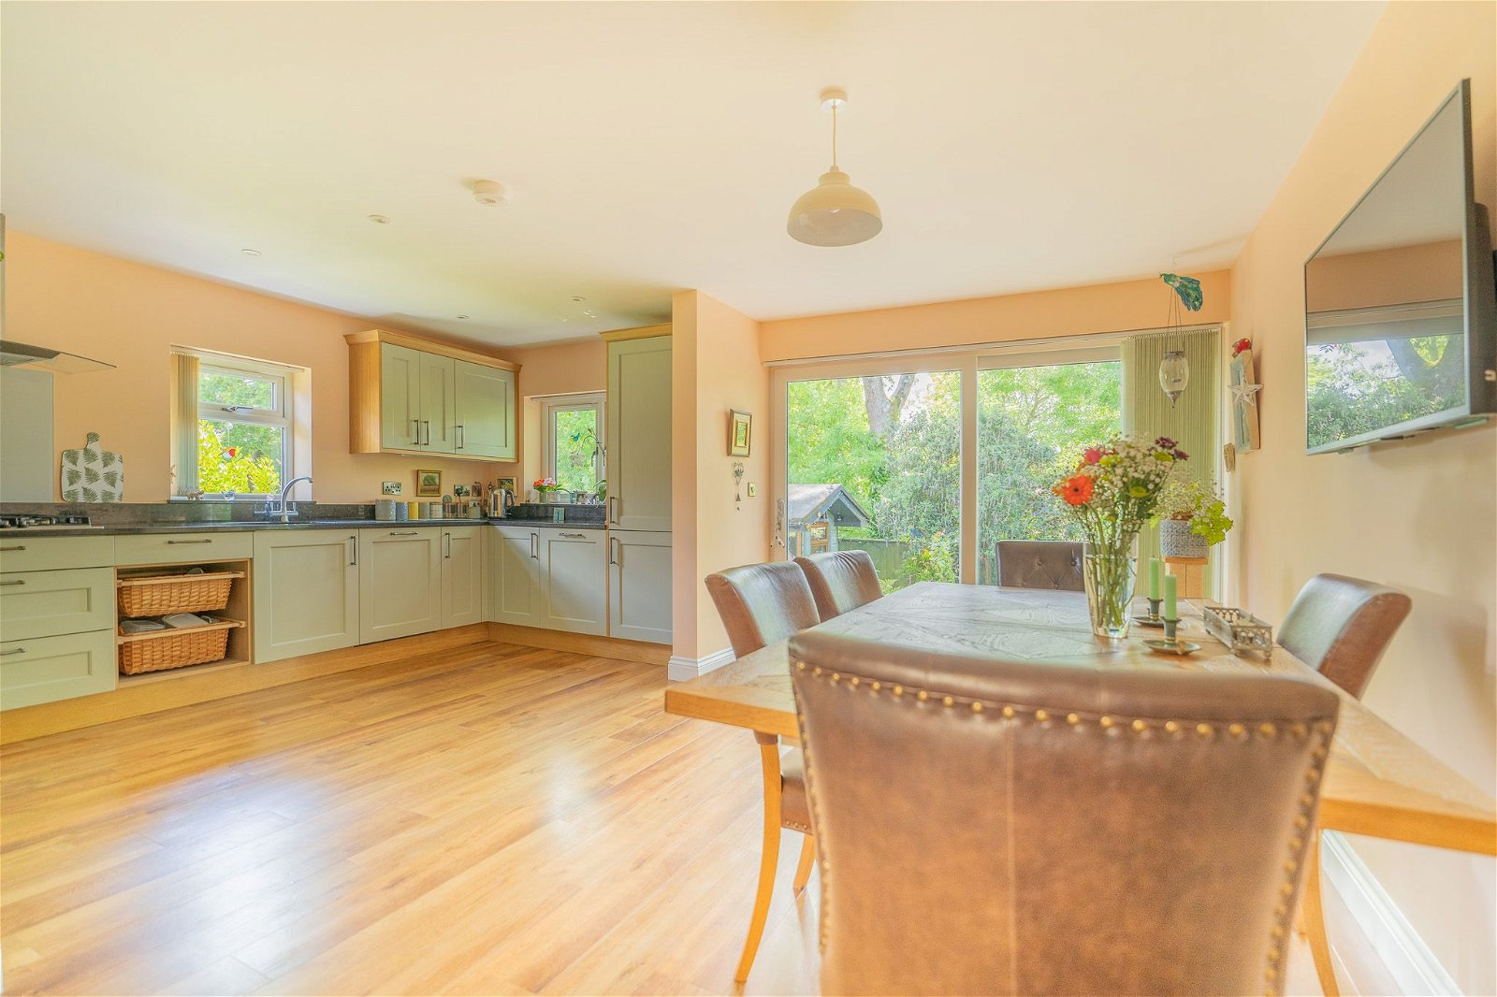
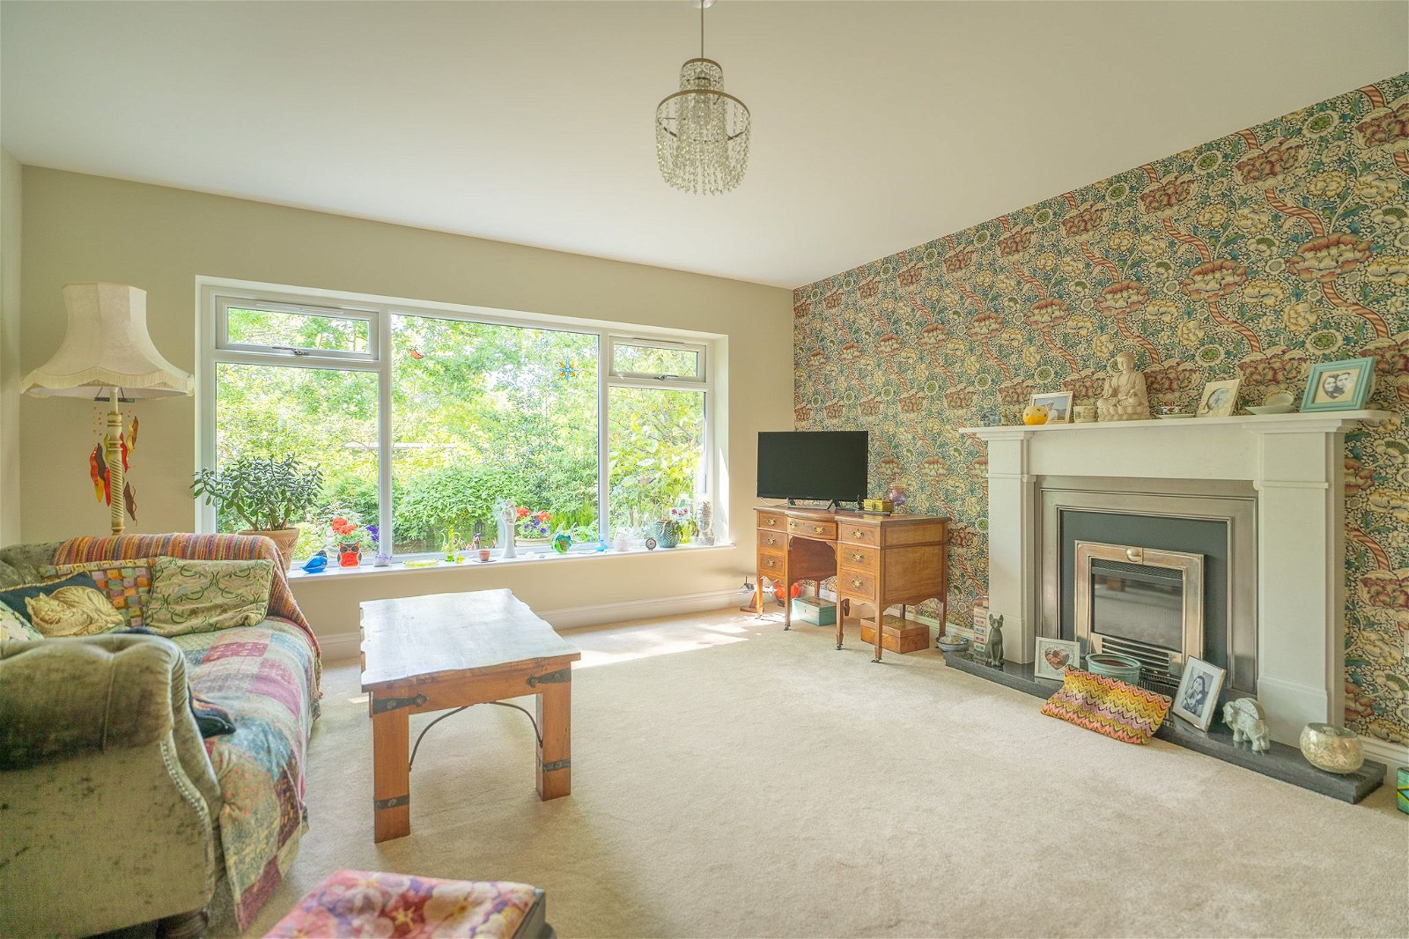
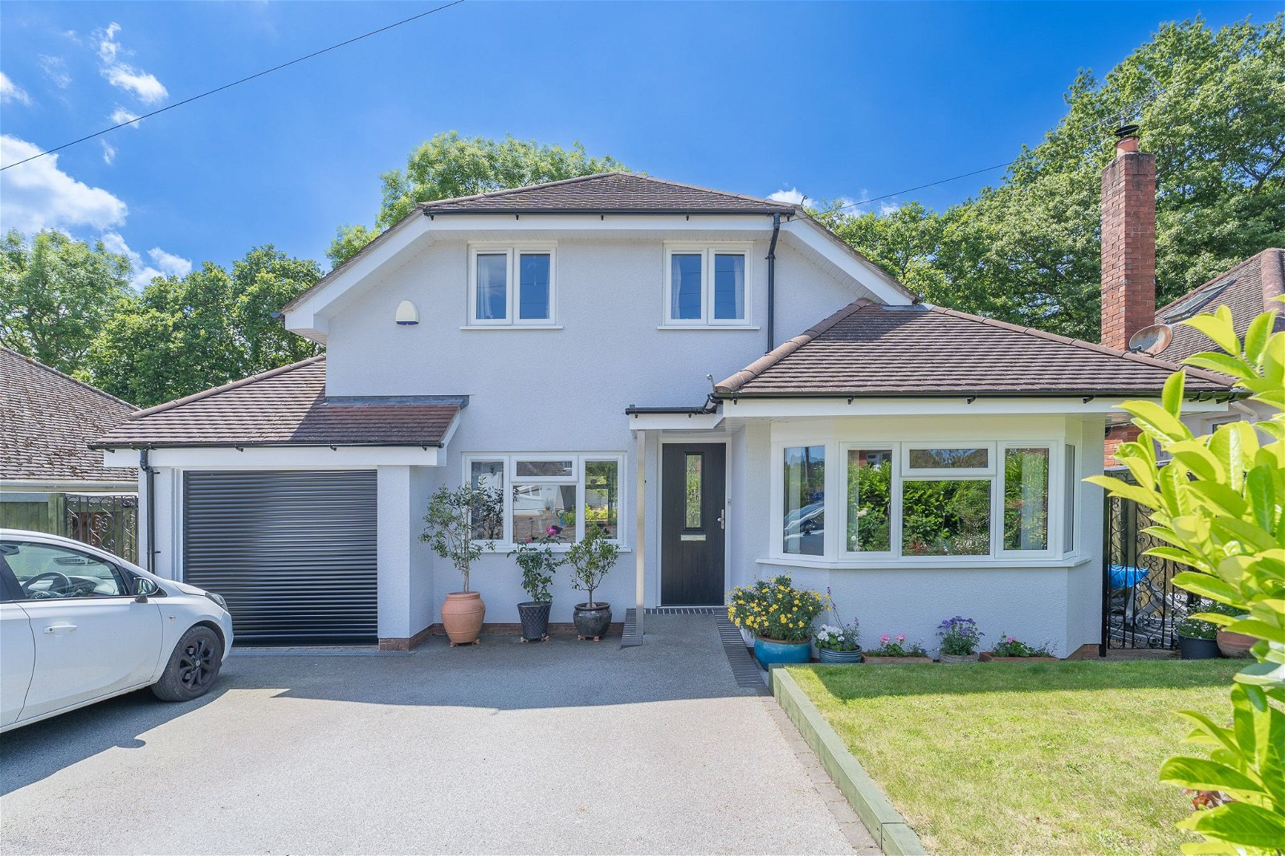
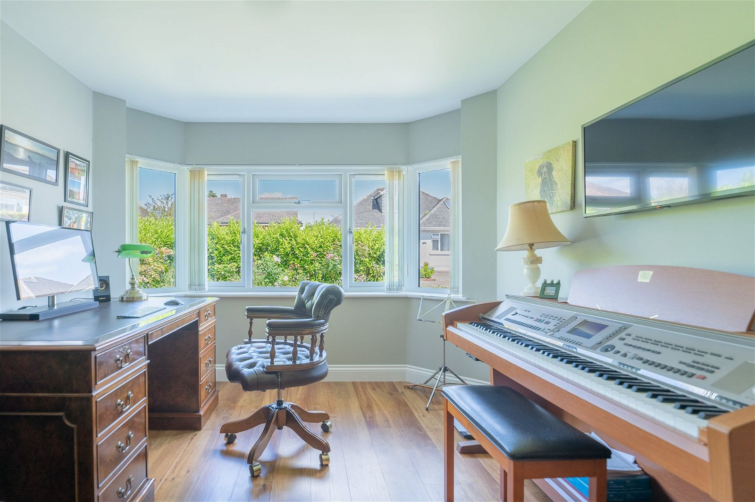
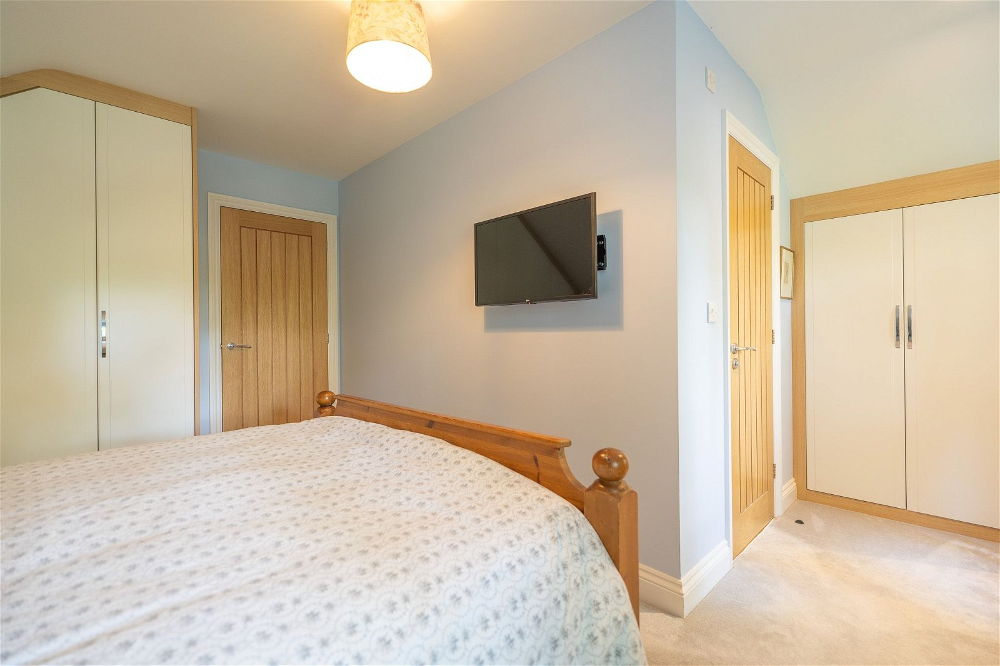
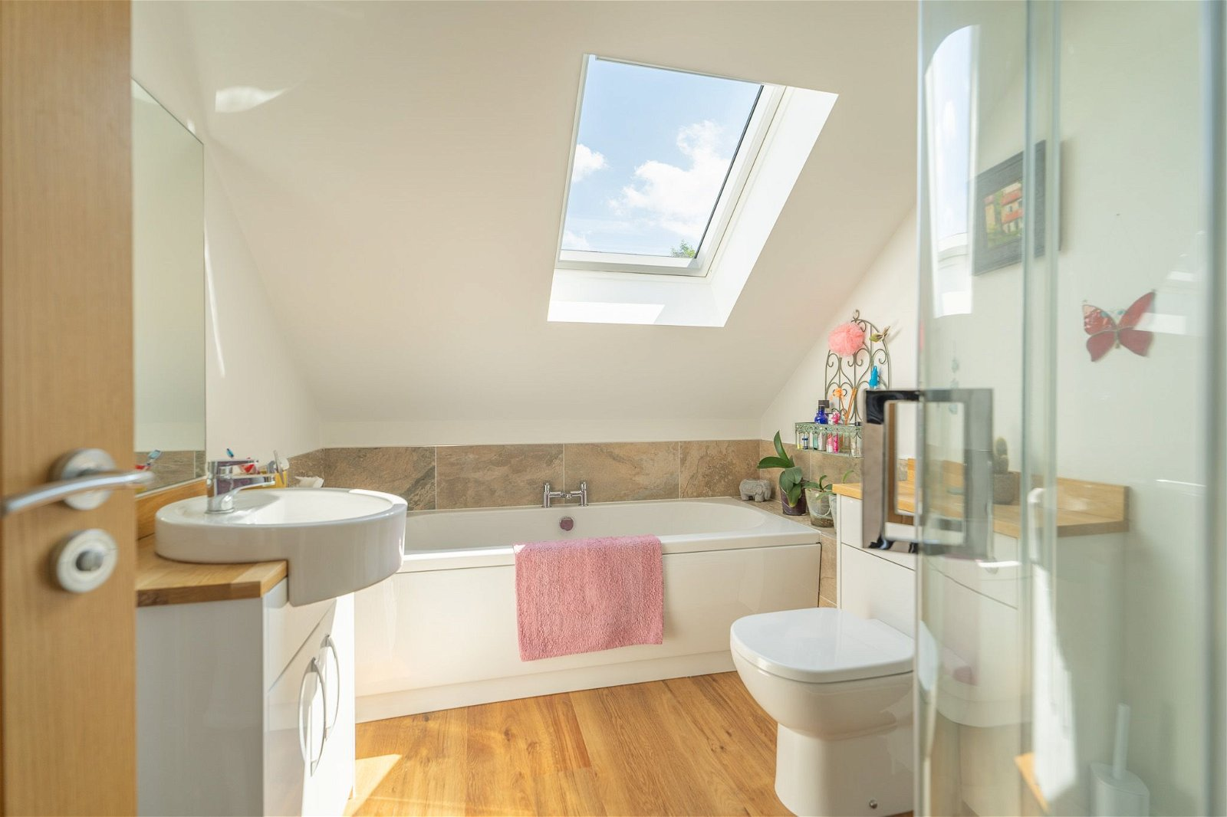
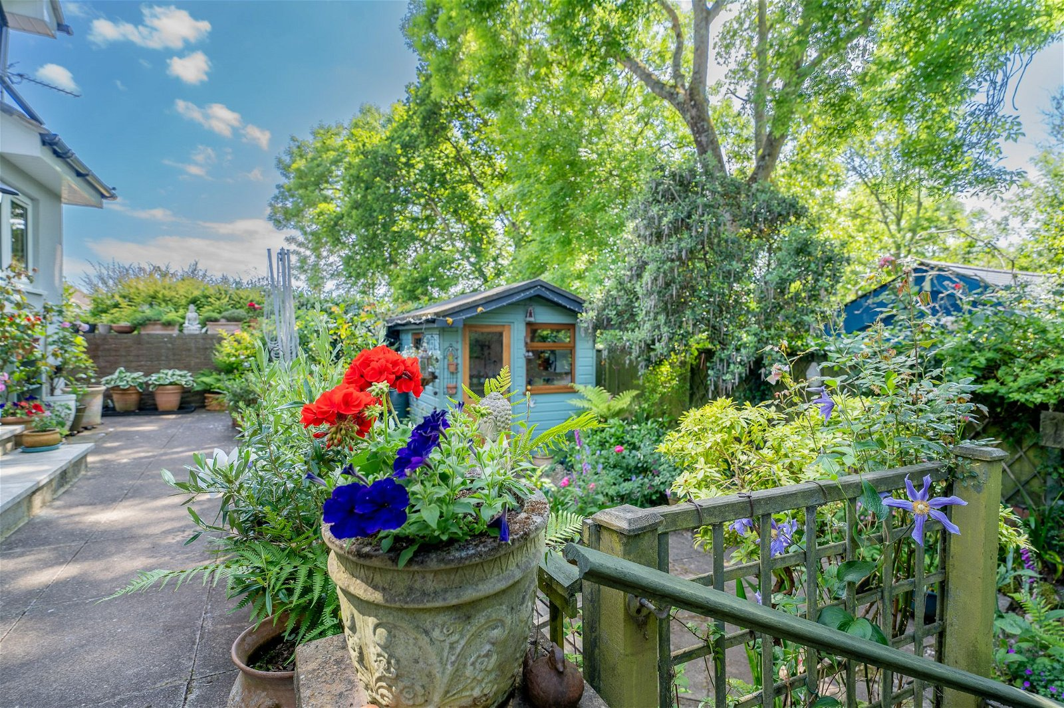
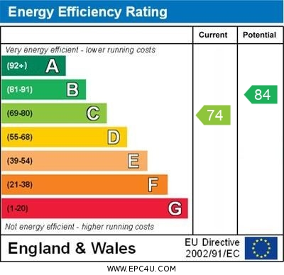
www.pennys.net
7 Withycombe Park Drive, Exmouth, EX8 4EJ
GUIDE PRICE £595,000
TENURE Freehold
Deceptively Spacious Detached House Which Has Been Rebuilt And Extended To Exacting Standards Over Recent Years And Now Offers High Quality And Adaptable Accommodation. Enjoying A Desirable Location With Colourful Gardens, Parking And Garage/Utility Area
Spacious Reception Hall * Ground Floor Cloakroom/Wc * Superb Open Plan Kitchen/Dining Room * Good Size Lounge * Three Versatile Ground Floor Bedrooms/Office/Family Rooms * Three First Floor Bedrooms * En-Suite Shower Room/Wc * Main Bathroom Suite * Gas Central Heating (Ground Floor With Underfloor Heating) * Upvc Double Glazed Windows * Stunning Home * Viewing Highly Recommended
Pennys Estate Agents Limited for themselves and for the vendor of this property whose agents they are give notice that:- (1) These particulars do not constitute any part of an offer or a contract. (2) All statements contained in these particulars are made without responsibility on the part of Pennys Estate Agents Limited. (3) None of the statements contained in these particulars are to be relied upon as a statement or representation of fact. (4) Any intending purchaser must satisfy himself/herself by inspection or otherwise as to the correctness of each of the statements contained in these particulars. (5) The vendor does not make or give and neither do Pennys Estate Agents Limited nor any person in their employment has any authority to make or give any representation or warranty whatever in relation to this property.
PENNYS ESTATE AGENTS
2 Rolle House, Rolle Street, Exmouth, Devon, EX8 2SN
Tel: 01395 264111 EMail: help@pennys.net

Slide 2
7 Withycombe Park Drive, Exmouth, EX8 4EJ
A rare opportunity to purchase a stunning detached residence located in a favoured area of Exmouth with colourful, well planned rear garden, double width driveway and garage/utility area. Offering flexible and adaptable accommodation, ideal for families or retirement buyers alike, the property has been finished to exacting standards and includes a wonderful open plan kitchen and dining room, attractive lounge, three versatile ground floor rooms which can be used as either bedrooms, study, gym or a family room. On the first floor there are three bedrooms including the main bedroom with a spacious en-suite shower room. Viewing of this unique property is highly recommended.
THE ACCOMMODATION COMPRISES: Entrance canopy with composite front door with patterned glass window inset giving access to:
SPACIOUS RECEPTION HALL: With impressive oak staircase rising to first floor with understairs storage cupboard beneath. Wood flooring with underfloor heating, access to utility/garage, recessed LED ceiling spotlighting. Mains smoke alarm.
GROUND FLOOR CLOAKROOM/WC: Stylishly fitted with circular wash hand basin sat on wooden display surface with matching splashback with cupboard and WC with push button flush beneath. Double glazed window with frosted glass, recessed ceiling LED spotlighting, wood flooring.
LOUNGE: 4.83m x 4.19m (15'10" x 13'9") Spacious room with feature fire surround housing living flame effect coal gas fire with marble hearth, TV point, radiator, underfloor heating, uPVC double glazed window to rear aspect enjoying a lovely tree lined outlook.
KITCHEN/DINING ROOM: 5.28m x 4.75m (17'4" x 15'7") A superb spacious open plan room with double glazed windows to side and rear elevations and sliding double glazed patio doors opening onto the rea garden, wood flooring with underfloor heating. The kitchen is a System Six kitchen and fitted with granite worktops with matching splashbacks, with inset one and a half bowl single drainer sink unit with integrated drainer. Range of cupboards and drawer units with built-in dishwasher, refuse drawer beneath worktops, inset five ring gas hob with glass splashback and stainless steel chimney style extractor hood over, built-in double oven with cupboards above and below, integrated fridge/freezer, upright larder cupboard fitted with deep pull-out drawer units, wall mounted cupboards incorporating a plate rack, recessed ceiling LED spotlighting in kitchen area and downlighting in dining area.
FAMILY /BEDROOM: 4.57m x 3m (15'0" x 9'10") A spacious room with measurement into double glazed bay window overlooking the front elevation with wood flooring and underfloor heating, TV point.
BEDROOM: 3.05m x 3.02m (10'0" x 9'11") Double glazed windows to side elevation, under floor heating.
BEDROOM/GYM: 2.84m x 2.72m (9'4" x 8'11") Another versatile room, currently used as a gym with feature wood flooring and underfloor heating. Recessed ceiling LED spotlighting with dimmer switch, TV point, uPVC double glazed window to front elevation.
FIRST FLOOR LANDING: Double glazed velux window, recessed ceiling LED spotlighting. Walk-in linen cupboard with slatted shelf and water cylinder.
BEDROOM 1: 4.5m x 4.29m (14'9" x 14'1") Superb main bedroom suite with a range of bespoke designed Sharps wardrobes, TV point, radiator, two sets of double glazed window both enjoying attractive tree lined outlook. Two access points to eaves boarded roof space.
EN-SUITE SHOWER ROOM/WC: 2.79m x 2.01m (9'2" x 6'7") Stylishly fitted and spacious en-suite comprising ease of access shower cubicle with curved shape splash screen doors, attractive tiled walls, fixed shower head hose and detachable rain fall shower head hose, circular wash hand basin set in wooden display surface with matching splashback with large fitted mirror over, built-in cupboard beneath, further wooden display surface with matching splashback with cupboards and WC concealed cistern push button flush beneath. Chrome heated towel rail, wood effect flooring, LED spotlighting and ceiling extractor fan.
BEDROOM 2: 4.57m x 2.74m (15'0" x 9'0") Radiator, TV point, access to boarded eaves storage space, radiator, uPVC double glazed window to front aspect.
BEDROOM 3: 3.71m x 2.82m (12'2" x 9'3") Radiator, uPVC double glazed window to front elevation, access to boarded eaves storage space.
BATHROOM/WC: 2.79m x 2.21m (9'2" x 7'3") Another stylishly fitted suite comprising bath with attractive tiled surround, circular wash hand basin set on wooden display surface with matching splashback and large fitted mirror over and cabinet beneath. WC with concealed cistern and push button flush with wooden display surface over with splashback. Good size shower cubicle with fixed rainfall shower head hose and detachable shower head hose. Tiled walls and curved shower splash screens, feature wood flooring, chrome heated towel rail.
OUTSIDE: To the front of the property is a double width resin driveway providing ample off road parking and leading to the GARAGE/UTILITY area. Lawned front garden edged with laurel hedging and colourful flower beds. Wrought iron gate gives access to side patio pathway with two outside cold water taps, bin store and storage sheds. The rear garden is a lovely feature of the property offering an array of colour from a variety of colourful shrubs and trees comprising of a patio sun terrace adjoining the rear of the property with a few steps leading down to a further patio and decorative stone garden area. There is also a GARDEN OFFICE/CABIN (2.18m x 2.18m (7'2" x 7'2"), insulated with electric wall heater and LED spotlighting with dimmer switch, fitted with display surface with cupboard under and wall mounted cupboard, double glazed windows. Patio side pathway with open storage area and gate giving access back around to the front of the property.
GARAGE/UTILITY AREA: 5.49m x 2.46m (18'0" x 8'1") Electric up and over door. To the rear of the garage is a utility area having worktop with inset single drainer sink unit, cupboards, plumbing for automatic washing machine and tumble dryer space beneath. Wall mounted gas boiler for hot water and central heating, electric consumer unit, double glazed window, power and light connected.

